Slide 1

Binary, ternary and quaternary Fe-rich slags: influence of Fe and Si substitution by Ca and Al on the atomic structure and reactivity
Christina Siakati, Alexios Douvalis, Arne Peys, Yiannis Pontikes
KU Leuven, Belgium

Slide 2
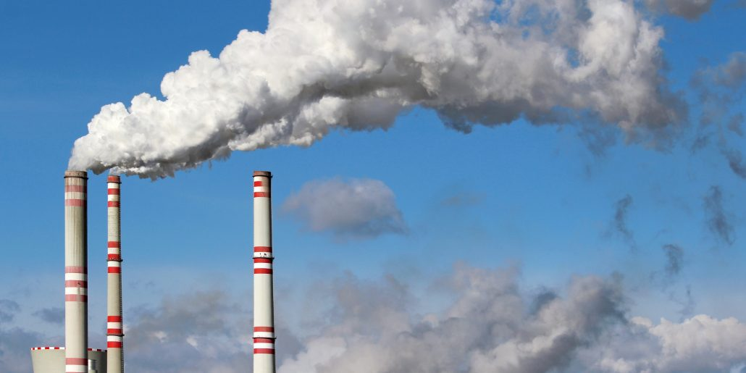
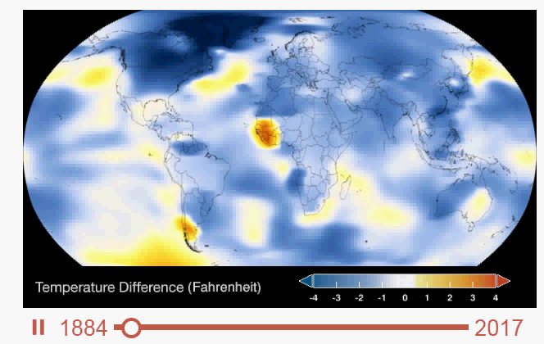
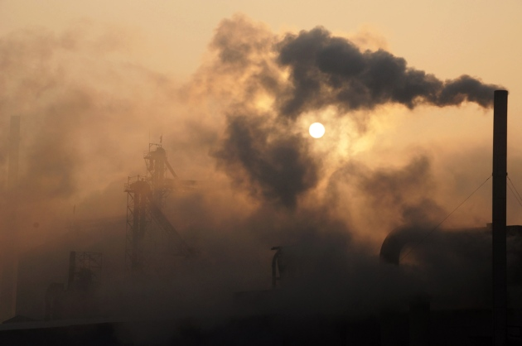
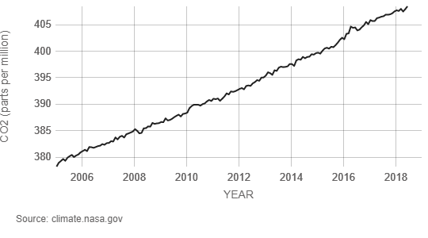
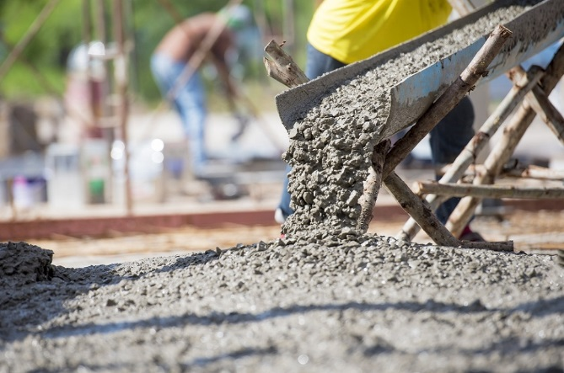
Alternative cement
Global warming
Cement production
CO₂ emissions
Less CO₂
CO₂
Source: climate.nasa.gov
8% of the worldwide amount of CO₂ emissions
1

Slide 3
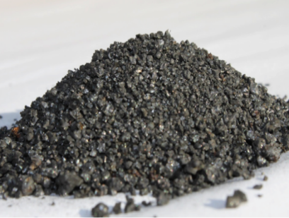
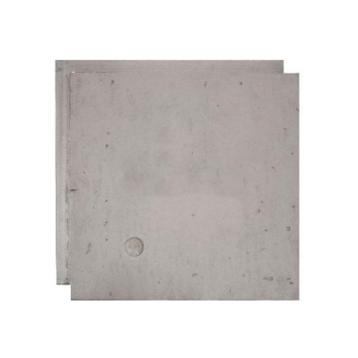
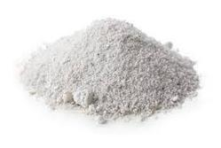
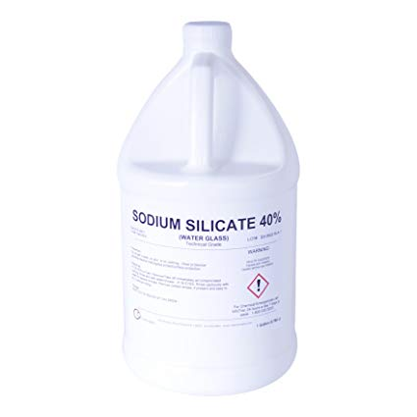
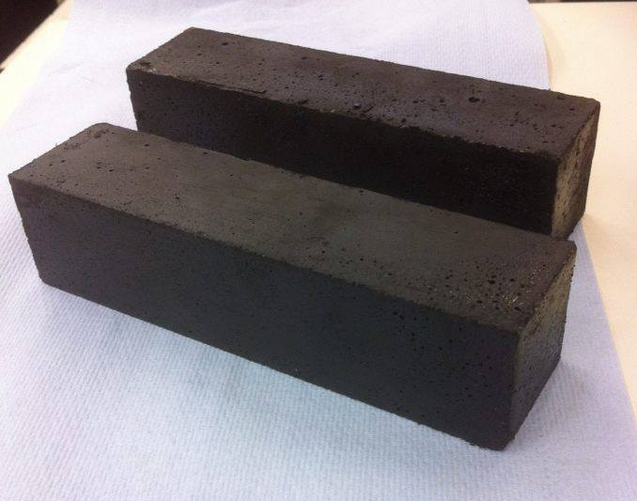
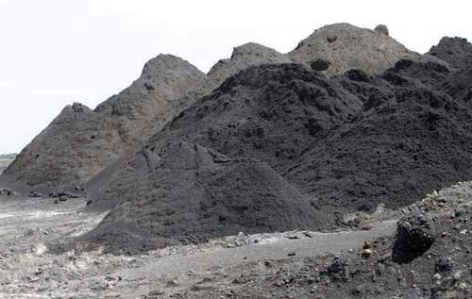
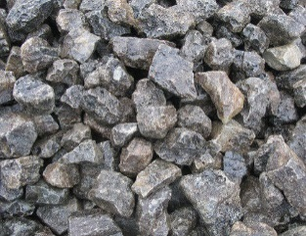
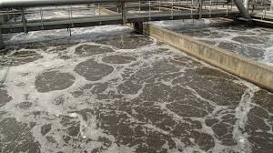
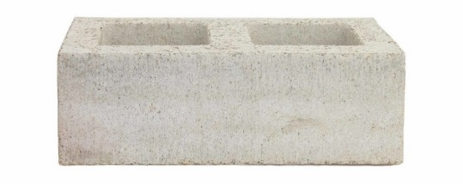
Alkali-activated materials
+
=
Alkali silicates
or
Alkali hydroxides
Inorganic polymer
Iron-rich silicate precursor
Alternative binder
Alumino/calcium silicate precursor
2
Notes:
Potential of using Fe-rich silicate sources as precursors. from sources such volcanic ashes, fe-rich soils, waste incinerator ashes and metallurgical by products

Slide 4
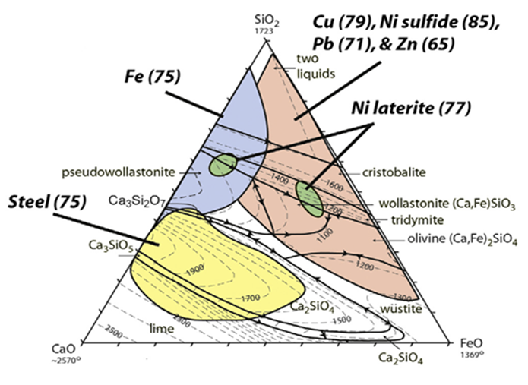
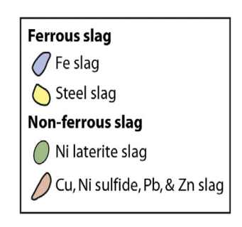
Alkali-activated materials
+
=
Inorganic polymer
Alkali-silicates
or
Alkali-hydroxides
Inorganic polymer
Iron-rich silicate precursor
Piatak et al. (2015), Applied Geochemistry
Only in Europe: ~3 Mtons/year fayalitic slag
~6 Mtons/year bauxite residue
2
Notes:
Specifically, the non-ferrous metallurgical industries generate large volumes of industrial process by products. As an example only in Europe we have aprox. 9Mtons produced per year .

Slide 5
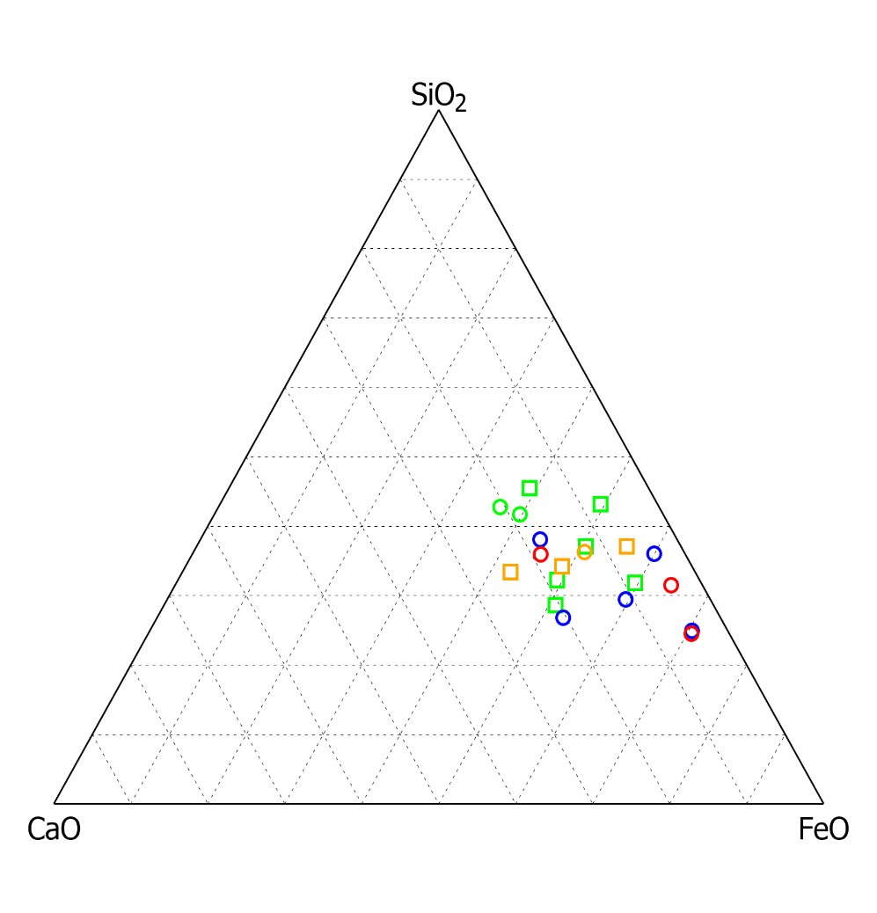
Design of Fe-rich slags
3
Notes:
In order to be able to tune the chemistry and the mineralogy of the precursors according to our needs, we decided to explore these Fe-rich systems with chemistries similar to non-ferrous metallurgy slags.

Slide 6
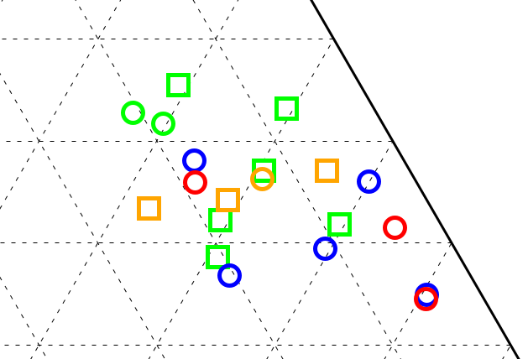
Design of Fe-rich slags
FeO_{x}-SiO₂
Copper slags
FeO_{x}-SiO₂-CaO
Lead slags
FeO_{x}-SiO₂-CaO-Al₂O₃
Bottom ashes …
Sample | Oxides | FeO (wt%) | SiO₂ (wt%) | CaO (wt%) | Al₂O₃ (wt%) | Others (wt%) | Density (g/cm³) | Glass fraction (wt%)
Binary | FeO_{x}-SiO₂ | 65.6 | 33.0 | 0.0 | 0.0 | 1.4 | 3.75 | 86
Ternary | FeO_{x}-SiO₂-CaO | 48.3 | 33.8 | 16.7 | 0.0 | 1.2 | 3.60 | 93
Quaternary | FeO_{x}-SiO₂-CaO-Al₂O₃ | 47.8 | 34.1 | 12.2 | 5.1 | 0.8 | 3.52 | 97
3
Notes:
0-25 wt% CaO, 15-50 wt% FeO, 25-45 wt% SiO2

Slide 7
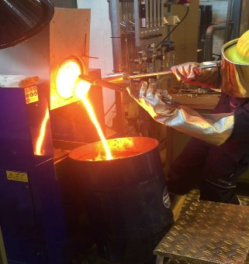
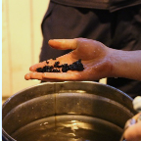
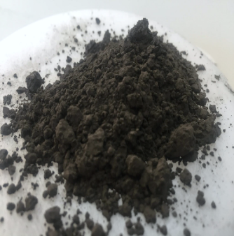
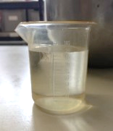
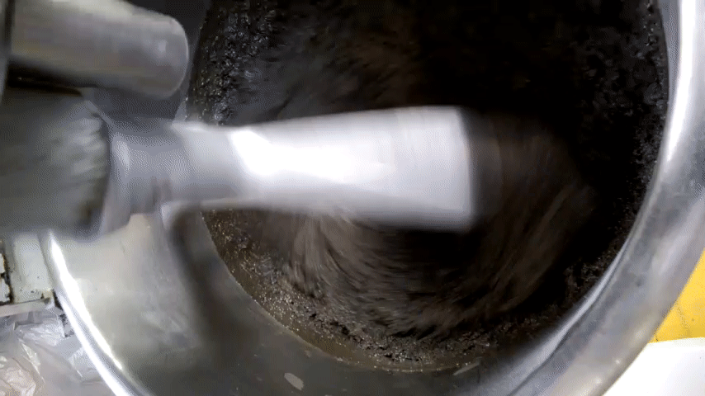
From slag to inorganic polymer
+
=
Quenching
Quenched slag
Slag powder
Activating solution
Inorganic polymer
Mixing
SiO₂/Na₂O=1.6 - H₂O/Na₂O=25
4
Notes:
Here, I will focus on three different parts.

Slide 8
From slag to inorganic polymer
+
=
Quenching
Quenched slag
Slag powder
Activating solution
Inorganic polymer
Mixing
SiO₂/Na₂O=1.6 - H₂O/Na₂O=25
Effect of composition on the nano-structure
Mössbauer spectroscopy
4

Slide 9
From slag to inorganic polymer
+
=
Quenching
Quenched slag
Slag powder
Activating solution
Inorganic polymer
Mixing
SiO₂/Na₂O=1.6 - H₂O/Na₂O=25
Effect of composition on reactivity
Isothermal calorimetry
4

Slide 10
From slag to inorganic polymer
+
=
Quenching
Quenched slag
Slag powder
Activating solution
Inorganic polymer
Mixing
SiO₂/Na₂O=1.6 - H₂O/Na₂O=25
Effect of composition on mechanical properties
Compressive strength
4

Slide 11
From slag to inorganic polymer
+
=
Quenching
Quenched slag
Slag powder
Activating solution
Inorganic polymer
Mixing
SiO₂/Na₂O=1.6 - H₂O/Na₂O=25
Effect of composition on the nano-structure
Mössbauer spectroscopy
4

Slide 12
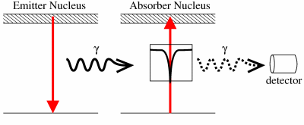
Environment of Fe ions on slag structure
⁵⁷Fe Mössbauer spectroscopy
http://www.rsc.org/membership/networking/interestgroups/mossbauerspect/intropart1.asp
5
Notes:
For evaluating the oxidation state, the magnetic properties etc. We actually measure the absorption of the g rays by the sample as a function of energy. This absorption is a function of the surroundings of the nucleous. These surroundings are quatified in 3 different ways.

Slide 13
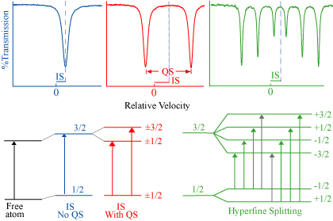
Environment of Fe ions on slag structure
⁵⁷Fe Mössbauer spectroscopy
Hyperfine interactions-Mössbauer parameters
Isomer
shift
http://www.rsc.org/membership/networking/interestgroups/mossbauerspect/intropart1.asp
https://serc.carleton.edu/msu_nanotech/methods/mossbauer.html
5
Notes:
The IS which is related to the electron density in the nucleous changing the energy levels. In the spectrum can be seen as a shift of the peak.

Slide 14
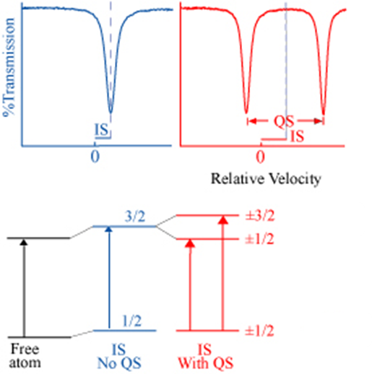
Environment of Fe ions on slag structure
⁵⁷Fe Mössbauer spectroscopy
Hyperfine interactions-Mössbauer parameters
Isomer
shift
Quadrupole
splitting
http://www.rsc.org/membership/networking/interestgroups/mossbauerspect/intropart1.asp
https://serc.carleton.edu/msu_nanotech/methods/mossbauer.html
5
Notes:
The QS which is related to the assymetric electronic environment and splits the excited energy levels of the nucleous. In the spectrum can be seen as a separation of these two peaks and we call it doublet. It gives info about the symmetry of the system.

Slide 15
Environment of Fe ions on slag structure
⁵⁷Fe Mössbauer spectroscopy
Hyperfine interactions-Mössbauer parameters
Isomer
shift
Quadrupole
splitting
Magnetic splitting
http://www.rsc.org/membership/networking/interestgroups/mossbauerspect/intropart1.asp
https://serc.carleton.edu/msu_nanotech/methods/mossbauer.html
5
Notes:
Finally the third one is the magnetic splitting which is actually the interaction of the nucleous and any surrounding magnetic field and we observe it as a sextet in the spectrum.

Slide 16
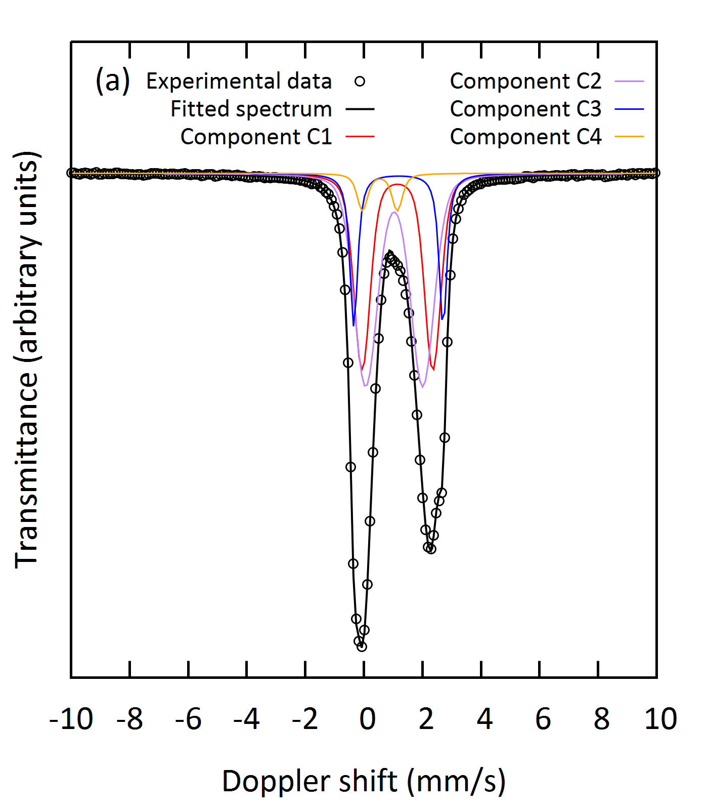
Environment of Fe ions on slag structure
⁵⁷Fe Mossbauer spectroscopy: FeO_{x}-SiO₂ binary slag
IS (mm/s) | QS (mm/s) | B_{hf} (kOe) | ΔQS or ΔB_{hf} (mm/s or kOe) | AA (%) | Component
1.25 | 2.42 | 0 | 0.4 | 33 | C1
1.14 | 1.95 | 0 | 0.67 | 48 | C2
0.65 | 1.19 | 0 | 0.22 | 4 | C3
1.28 | 3.05 | 0 | 0.1 | 15 | C4
C1, C2 components: Fe²⁺, glassy phase
C3 component: Fe³⁺, glassy phase
C4 component: fayalite (Fe₂SiO₄)
IS: Isomer shift (relative to a-Fe at 300 K), QS: quadrupole splitting, ΔQS: spreading of QS, B_{hf}: magnetic field, AA: relative absorption area. Errors: ±0.02 mm/s for IS and QS, ±0.3 T for B_{hf} and ±5% for AA.
6

Slide 17
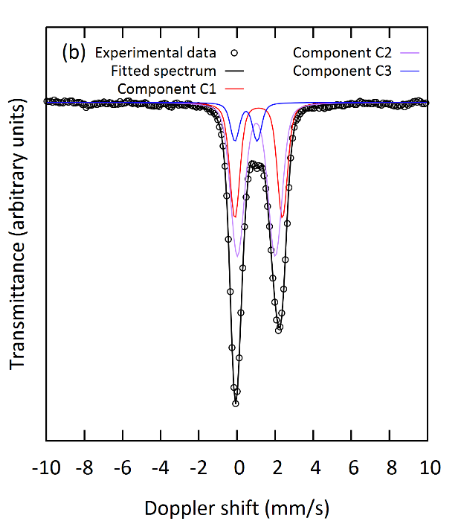
Environment of Fe ions on slag structure
⁵⁷Fe Mossbauer spectroscopy: FeO_{x}-SiO₂-CaO ternary slag
IS (mm/s) | QS (mm/s) | B_{hf} (kOe) | ΔQS or ΔB_{hf} (mm/s or kOe) | AA (%) | Component
1.24 | 2.49 | 0 | 0.40 | 33 | C1
1.12 | 1.98 | 0 | 0.60 | 57 | C2
0.58 | 1.17 | 0 | 0.33 | 10 | C3
C1, C2 components: Fe²⁺, glassy phase
C3 component: Fe³⁺, glassy phase
IS: Isomer shift (relative to a-Fe at 300 K), QS: quadrupole splitting, ΔQS: spreading of QS, B_{hf}: magnetic field, AA: relative absorption area. Errors: ±0.02 mm/s for IS and QS, ±0.3 T for B_{hf} and ±5% for AA.
7

Slide 18
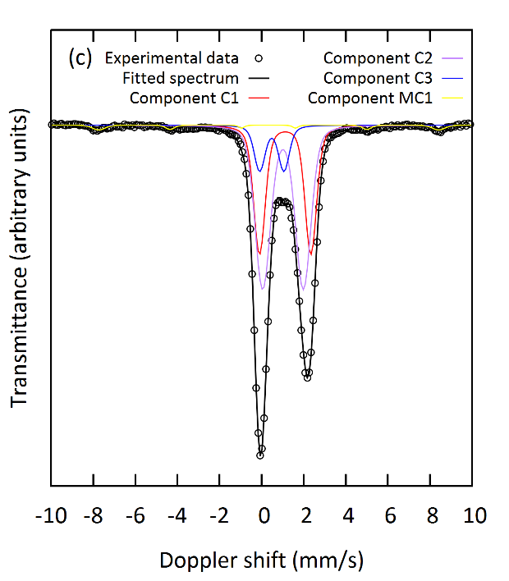
Environment of Fe ions on slag structure
⁵⁷Fe Mossbauer spectroscopy: FeO_{x}-SiO₂-CaO-Al₂O₃ quaternary slag
IS (mm/s) | QS (mm/s) | B_{hf} (kOe) | ΔQS or ΔB_{hf} (mm/s or kOe) | AA (%) | Component
1.22 | 2.44 | 0 | 0.42 | 33 | C1
1.12 | 1.93 | 0 | 0.60 | 53 | C2
0.59 | 1.15 | 0 | 0.38 | 11 | C3
0.44 | 0.01 | 502 | 15.23 | 3 | MC1
C1, C2 components: Fe²⁺, glassy phase
C3 component: Fe³⁺, glassy phase
MC1 component: magnetite (Fe₃O₄)
IS: Isomer shift (relative to a-Fe at 300 K), QS: quadrupole splitting, ΔQS: spreading of QS, B_{hf}: magnetic field, AA: relative absorption area. Errors: ±0.02 mm/s for IS and QS, ±0.3 T for B_{hf} and ±5% for AA.
8

Slide 19
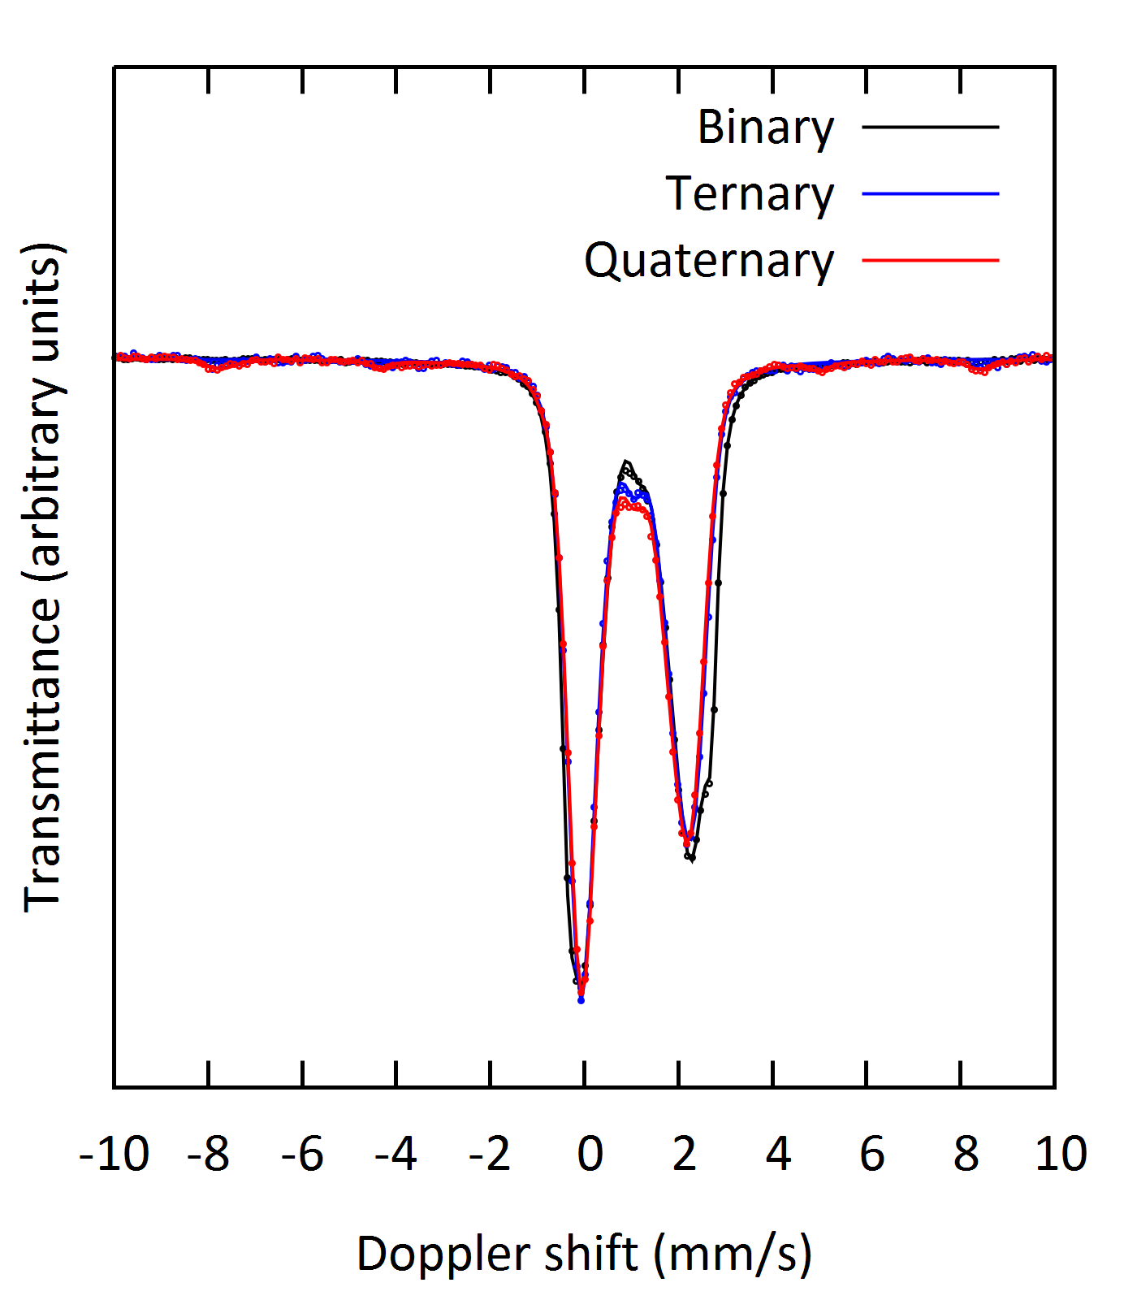
Environment of Fe ions on slag structure
Similar Mössbauer parameter values of the glassy phase
Differences due to the crystalline phases
Similar local environment of Fe ions
9
Notes:
Fe3+ : IS:0.25-0.55 and QS:0-1.5
Fe2+: IS:0.75-1.5 and QS: 0-4

Slide 20
From slag to inorganic polymer
+
=
Quenching
Quenched slag
Slag powder
Activating solution
Inorganic polymer
Mixing
SiO₂/Na₂O=1.6 - H₂O/Na₂O=25
Effect of composition on reactivity
Isothermal calorimetry
10

Slide 21
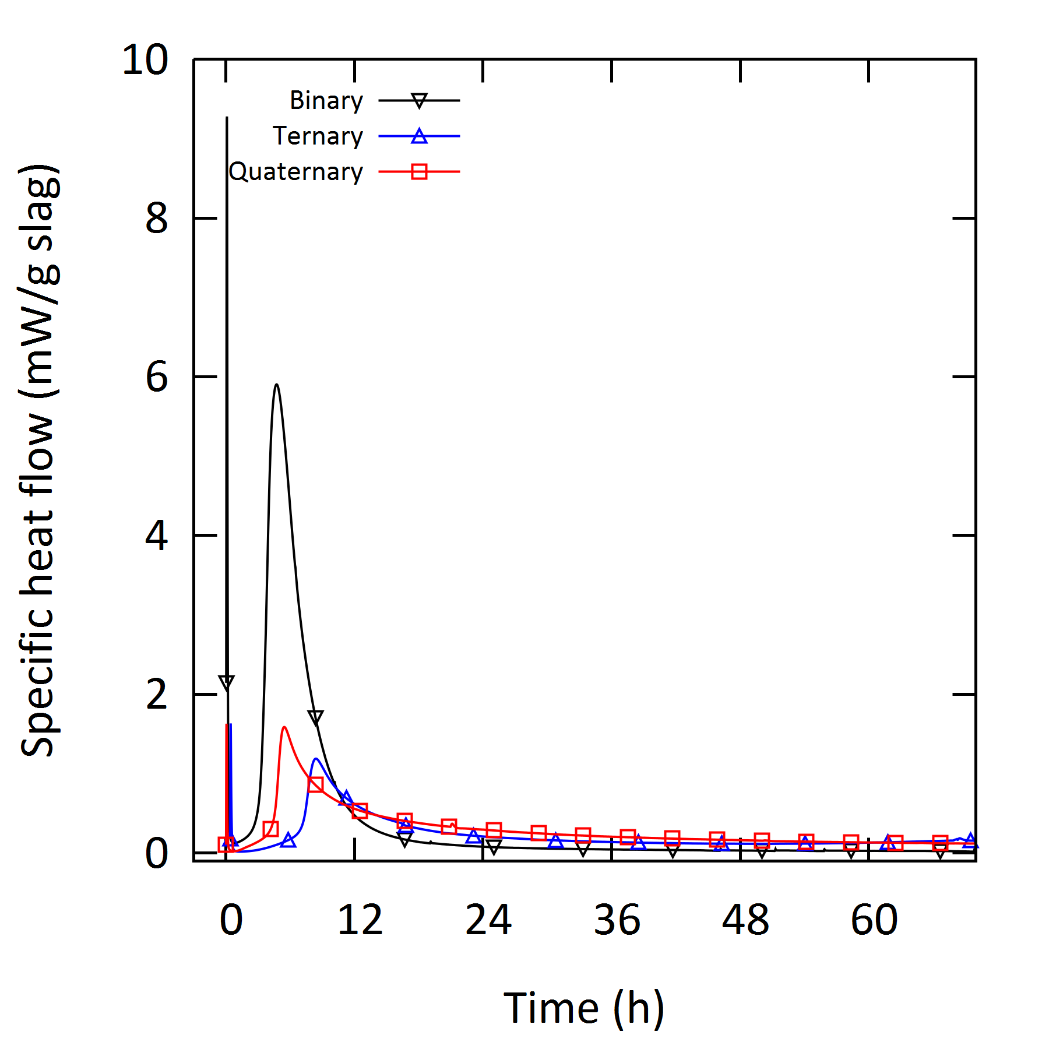
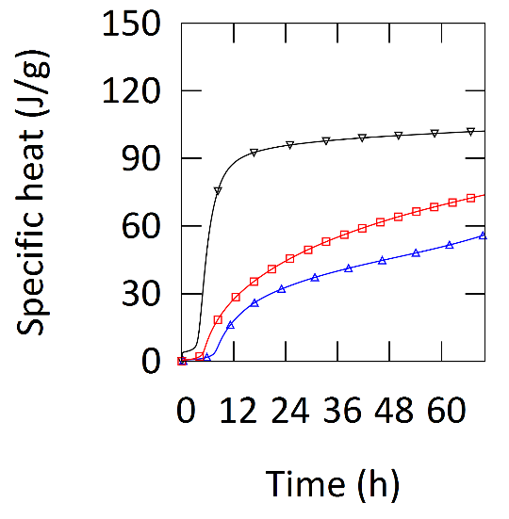
Reaction kinetics
Isothermal calorimetry
SiO₂/Na₂O=1.6 - H₂O/Na₂O=25
2 exothermic peaks:
  Initial heat
  Dissolution/polymerization
Incorporation of Ca and Al influences the reaction kinetics
11
Notes:
Instant absorption of the solution on the surface of the slag powder and mainly to the start of the dissolution.
The origin of the high cumulative heat of the binary system is not clear at this point, although, also looking into earlier work it seems to be connected with the content of Fe in the slag.

Slide 22
From slag to inorganic polymer
+
=
Quenching
Quenched slag
Slag powder
Activating solution
Inorganic polymer
Mixing
SiO₂/Na₂O=1.6 - H₂O/Na₂O=25
Effect of composition on mechanical properties
Compressive strength
12

Slide 23
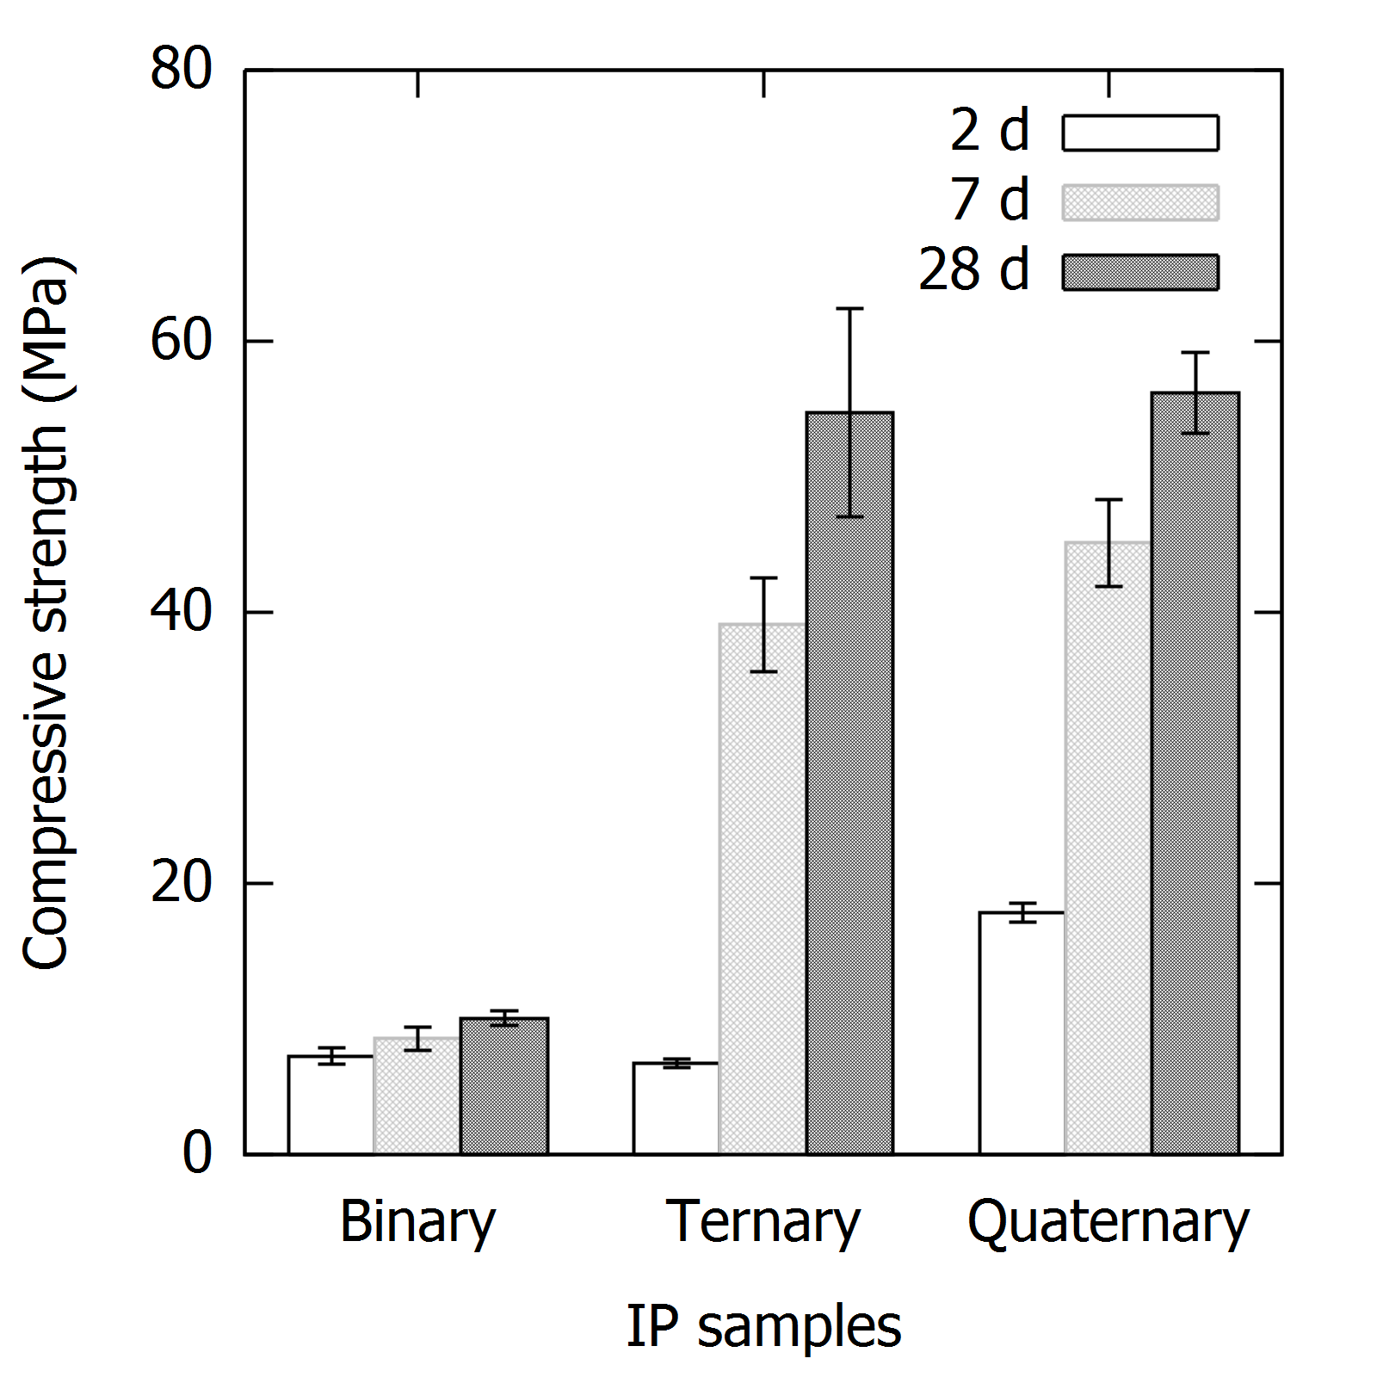
Compressive strength evolution
IP samples | 2d (MPa) | 7d (MPa) | 28d (MPa)
Binary FeO_{x}-SiO₂ | 7.3 | 8.5 | 10.1
Ternary FeO_{x}-SiO₂-CaO | 6.7 | 39.1 | 54.7
Quaternary FeO_{x}-SiO₂-CaO-Al₂O₃ | 17.9 | 45.1 | 56.2
13
Notes:
The early age strength at 2 days of the binary and ternary sample was significant lower compared to the quaternary one

Slide 24
Compressive strength evolution
IP samples | 2d (MPa) | 7d (MPa) | 28d (MPa)
Binary FeO_{x}-SiO₂ | 7.3 | 8.5 | 10.1
Ternary FeO_{x}-SiO₂-CaO | 6.7 | 39.1 | 54.7
Quaternary FeO_{x}-SiO₂-CaO-Al₂O₃ | 17.9 | 45.1 | 56.2
Early age strength:
  Binary & Ternary => Low strength
  Quaternary => Higher strength
13

Slide 25
Compressive strength evolution
IP samples | 2d (MPa) | 7d (MPa) | 28d (MPa)
Binary FeO_{x}-SiO₂ | 7.3 | 8.5 | 10.1
Ternary FeO_{x}-SiO₂-CaO | 6.7 | 39.1 | 54.7
Quaternary FeO_{x}-SiO₂-CaO-Al₂O₃ | 17.9 | 45.1 | 56.2
Early age strength:
  Binary & Ternary => Low strength
  Quaternary => Higher strength
13
Notes:
The 7 days strength was 8, 39 and 41 MPa, indicating a large strength increase of the ternary and quaternary samples. position on strength development

Slide 26
Compressive strength evolution
IP samples | 2d (MPa) | 7d (MPa) | 28d (MPa)
Binary FeO_{x}-SiO₂ | 7.3 | 8.5 | 10.1
Ternary FeO_{x}-SiO₂-CaO | 6.7 | 39.1 | 54.7
Quaternary FeO_{x}-SiO₂-CaO-Al₂O₃ | 17.9 | 45.1 | 56.2
Early age strength:
  Binary & Ternary => Low strength
  Quaternary => Higher strength
Later age strength:
  Binary => Low strength
  Ternary & Quaternary => Higher strength
13
Notes:
The later age strength at 28 days showed again a significant strength increase with respect to the earlier strengths for these two samples while the strength of the binary sample remains quite low. From these results we can really see the influence of the composition on strength development

Slide 27
Conclusions
Fe-rich silicate precursors for inorganic polymer synthesis
Binary
Ternary
Quaternary
Heat release
FeO_{x}-SiO₂
>
Heat release
FeO_{x}-SiO₂-CaO
≈
Heat release
FeO_{x}-SiO₂-CaO-Al₂O₃
Early strength
FeO_{x}-SiO₂
≈
Early strength
FeO_{x}-SiO₂-CaO
<
Early strength
FeO_{x}-SiO₂-CaO-Al₂O₃
Late strength
FeO_{x}-SiO₂
<
Late strength
FeO_{x}-SiO₂-CaO
≈
Late strength
FeO_{x}-SiO₂-CaO-Al₂O₃
14

Slide 28

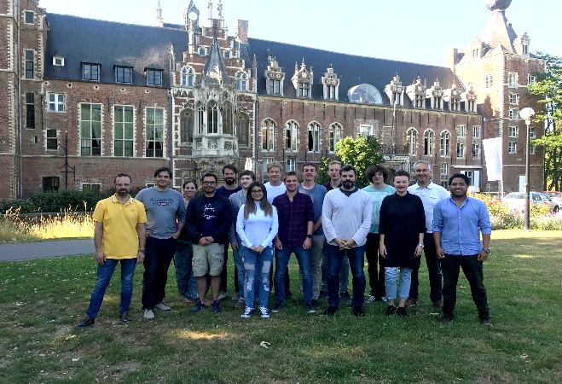
https://www.mtm.kuleuven.be/Onderzoek/sremat
15

Slide 29


Thank you for your attention
christina.siakati@kuleuven.be
This project has received funding from the European Union’s EU Framework Programme for Research and Innovation Horizon 2020 under Grant Agreement No 721185

Slide 32
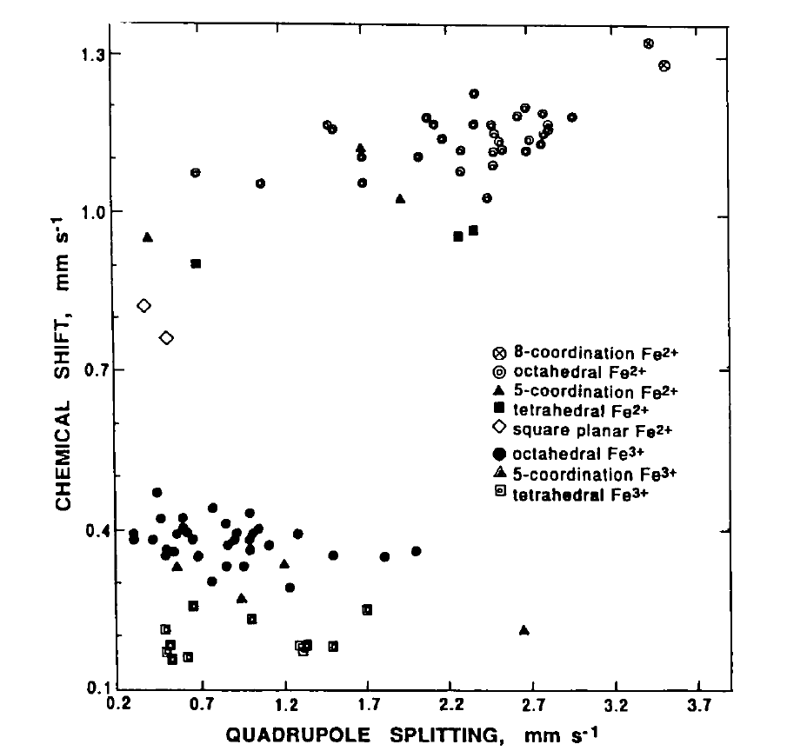
Burns et al., (1994)

Slide 33
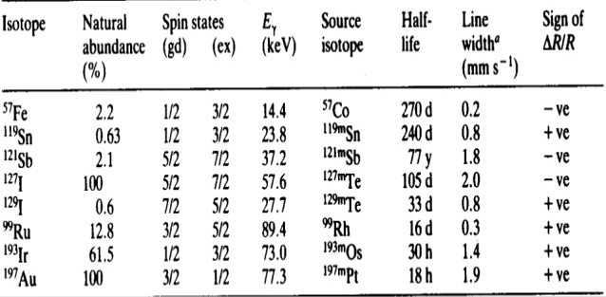
Mossbauer: recoilless γ ray resonant emission and absorption originating from changes in energy states of he nucleus
Common isotopes
Notes:
Sn tin, antimony Sb

